Slide 1

STOCK MARKET ANALYSIS
PROJECT 420 – GROUP 1

Slide 2
BUSINESS PROBLEM
Predict Reliance Industries Stock Price for the Next 30 Days
The goal of this project is to build a predictive model that forecasts the stock price of Reliance Industries for the next 30 days.
This model will leverage historical stock data and consider both short-term and long-term trends.
Additionally, the project will analyze the impact of significant external events on the stock price.

Slide 3
PROJECT WORK FLOW
Data Preprocessing and EDA
Model Evaluation
Model Feedback
Deployment
Model Building

Slide 4
DATA retrieval
The yfinance library is installed for fetching stock data.
The yfinance and pandas modules are imported for data handling.
The stock symbol and date range are defined for data retrieval.
Stock data is downloaded using the defined symbol and date range.
The day with the highest trading volume is identified.
The prices for the day with the most traded quantity are retrieved.
A new DataFrame is created to store the most traded day’s information.
The DataFrame is saved to a CSV file named RELIANCE_most_traded_quantity_data.csv.

Slide 5
DATA SET DETAILS
The dataset is a time series of Reliance Industries' stock market data, spanning from July 1, 2014, to June 28, 2024, with 2,462 trading days. It includes the following columns:
Open (float64): Opening price of the stock each day.
High (float64): Highest price during the day.
Low (float64): Lowest price during the day.
Close (float64): Closing price each day.
Adj Close (float64): Adjusted closing price accounting for stock splits/dividends.
Volume (int64): Total shares traded each day.
Avg Price (float64): Average price for the day.
20 Day MA (float64): 20-day moving average; 19 initial missing values.
50 Day MA (float64): 50-day moving average; 49 initial missing values.

Slide 6
Data Description
1. Open Price: - The average `Open` price is ₹1,368.97, with significant variation (standard deviation of ₹808.49). Prices range from ₹373.32 to ₹3,062.05, with a median of ₹1,171.47.
2. High price : The `High` price averages ₹1,383.28 and varies widely (standard deviation of ₹816.01). It ranges from ₹373.82 to ₹3,162.00, with a median of ₹1,181.50.
3. Low Price : The `Low` price has an average of ₹1,353.96 and a standard deviation of ₹800.67. It spans from ₹364.11 to ₹3,062.05, with a median of ₹1,158.69.
4. Close Price: The `Close` price averages ₹1,368.14, with a standard deviation of ₹808.26. It ranges from ₹370.65 to ₹3,130.80, with a median of ₹1,169.02.
5. Adjusted Close Price: The `Adjusted Close` price averages ₹1,351.42 and varies with a standard deviation of ₹813.15. Prices range from ₹349.55 to ₹3,130.80, with a median of ₹1,147.26.
6. Volume: The average `Volume` is 9,206,989, with a large standard deviation of 6,760,046. It ranges from 0 to 71,341,680, with a median of 7,323,024.

Slide 7
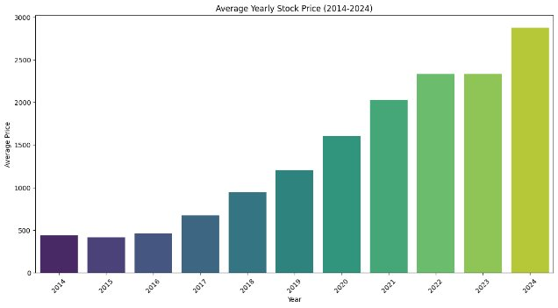
EDA
Yearly average stock prices from 2014 - 2024

Slide 8
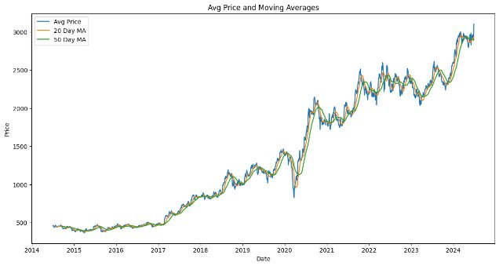
This chart shows the average price of an asset over time with two moving averages: a 20-day (orange) and a 50-day (green).
Key Points:
Avg Price (Blue Line): Reflects the asset's daily closing price changes.
20-Day MA (Orange): Indicates short-term trends.
50-Day MA (Green): Shows long-term trends.
Observations:
Trend: Overall upward trend, especially after 2020.
Crossovers: 20-day crossing above 50-day suggests a bullish trend; crossing below indicates bearish.

Slide 9
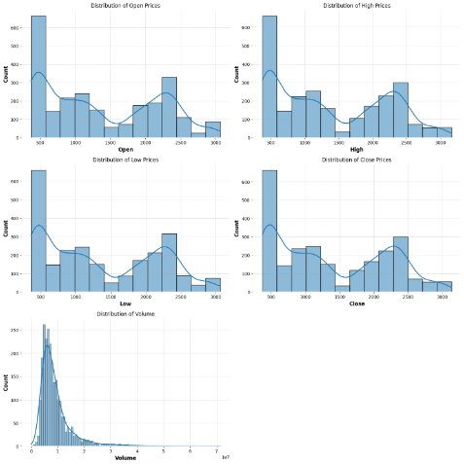
Add a funny Quote
“QUOTES…
Variation of the data through the years

Slide 10
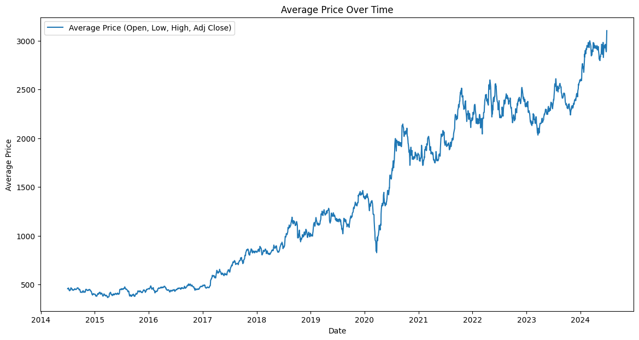
Graph showing price action of Reliance stock

Slide 11
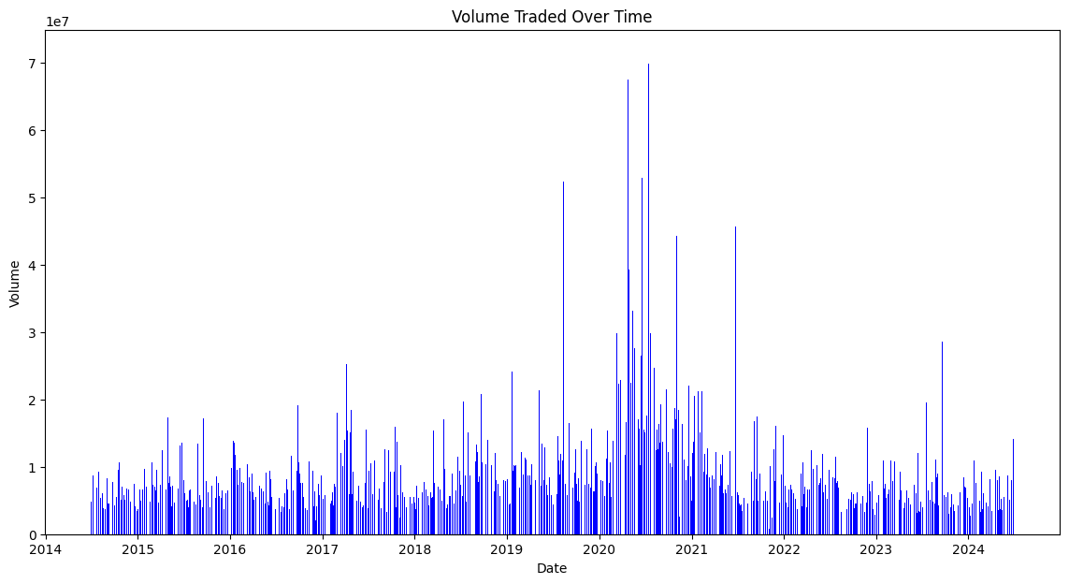
Graph showing Volume action of Reliance stock

Slide 12
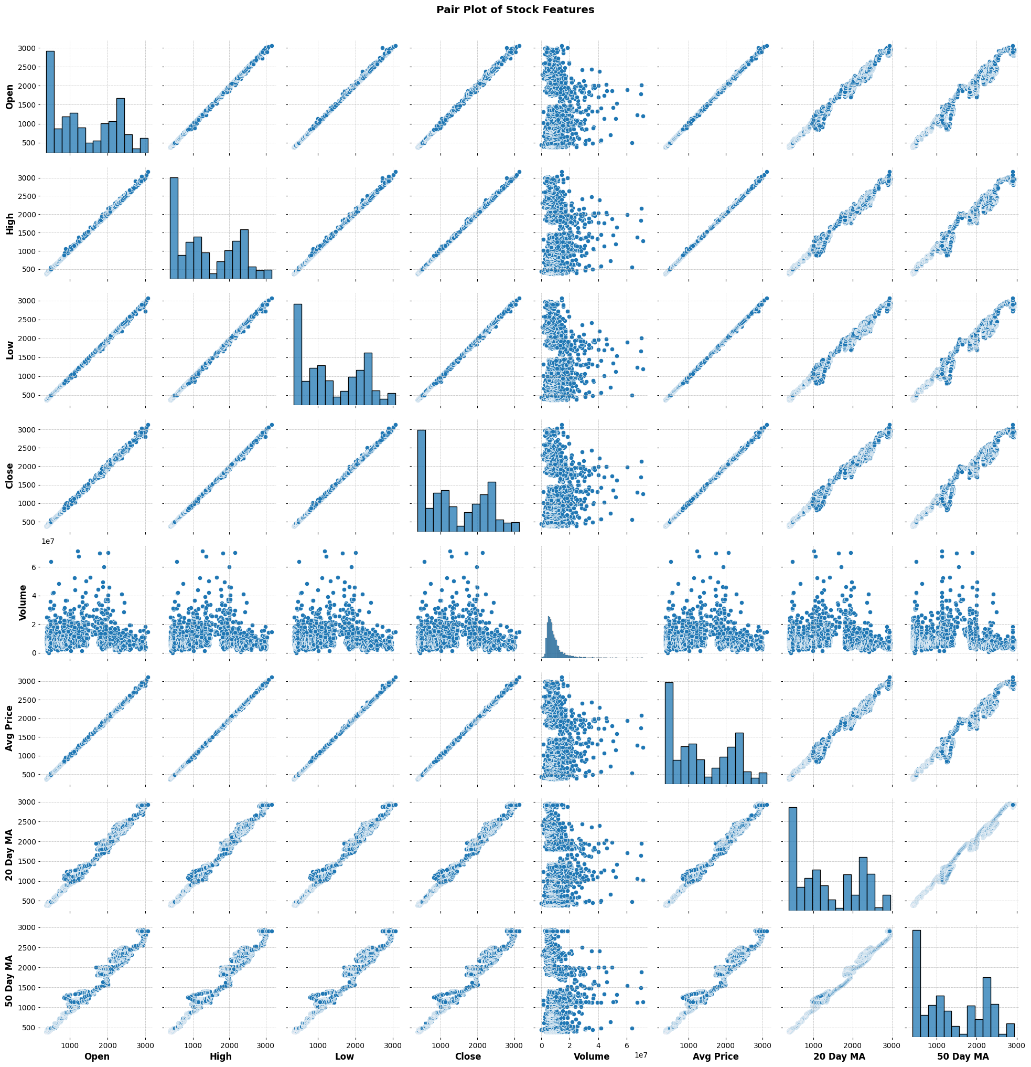
Pairplot
High Correlation: Open, High, Low, Close, Avg Price, 20 Day MA, and 50 Day MA are closely correlated, often forming linear patterns.
Volume: Scattered distribution with other features, indicating less direct correlation with price movements.

Slide 13
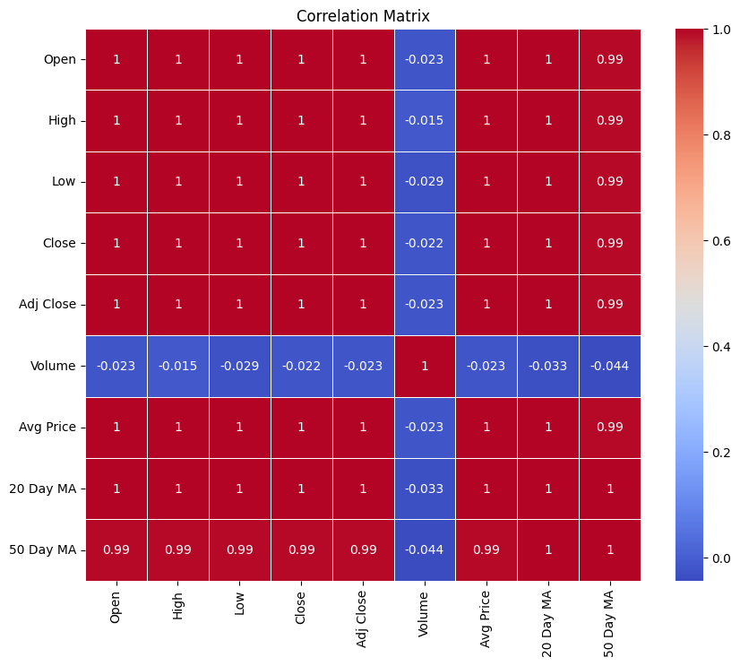
Correlations related to the stock
Model Building

Slide 14
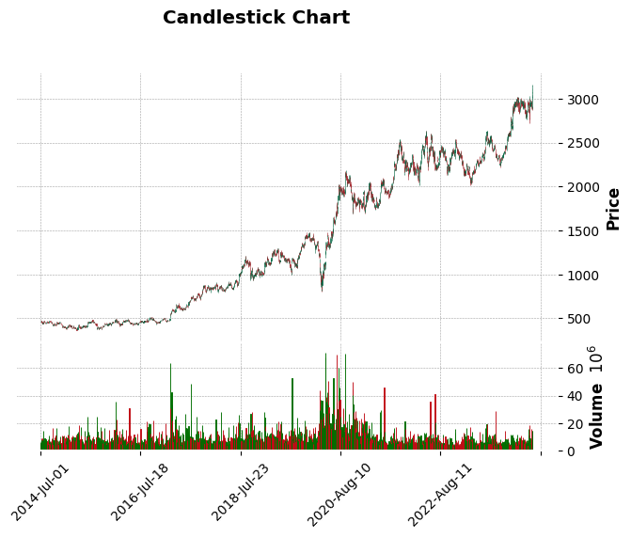
Mplfinance has been installed to plot a candle stick plot.

Slide 15
CHECKING FOR THE STATIONARY PROPERTY OF THE DATA
ADF Test: Checks if the time series is stationary. If the p-value is less than 0.05, the series is stationary.
KPSS Test: Complements the ADF test by checking if the series is stationary around a trend. If the p-value is less than 0.05, the series is non-stationary.
Differencing: Removes trends by subtracting the previous observation from the current one, which helps in making the series stationary.
Exponential Smoothing: Smooths the series to remove noise and trends, making it easier to analyze.
Plotting ACF/PACF: Helps to visualize correlations in the time series, which is useful for model selection.
KPSS Test with Differencing
Applying differencing and the KPSS test helps to make the series stationary. After differencing, the KPSS test usually shows that the series is stationary, indicating that the differencing was successful.

Slide 16
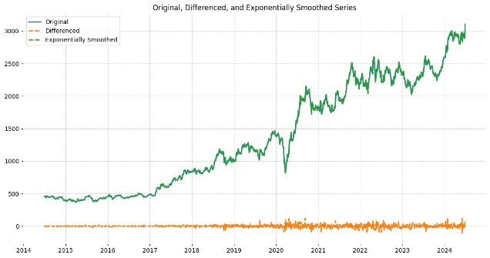
Add Pictures
Picture #1
Picture #2
Picture #3

Slide 17
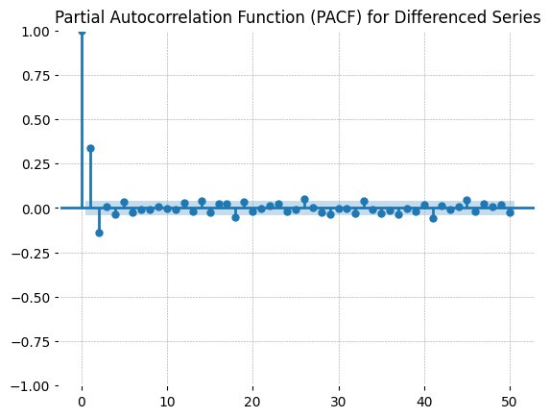
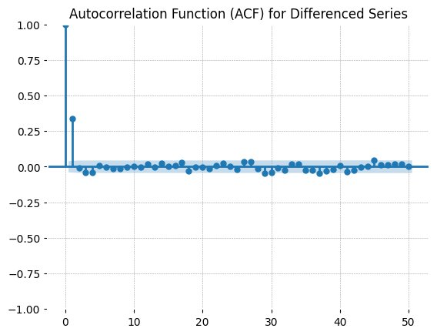
Add Pictures
Detrending and making the data stationary
Picture #1
Picture #3

Slide 18
Modelling and comparison between arima, sarimax and holt-winter
Based on the error metrics, SARIMAX performs slightly better than ARIMA, likely due to its ability to incorporate seasonality and additional variables. Holt-Winters, while effective for capturing seasonality, may not be the best fit for this particular dataset compared to ARIMA and SARIMAX.

Slide 19
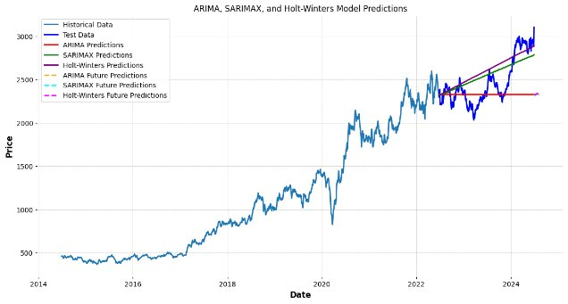
Results of the modelling

Slide 20
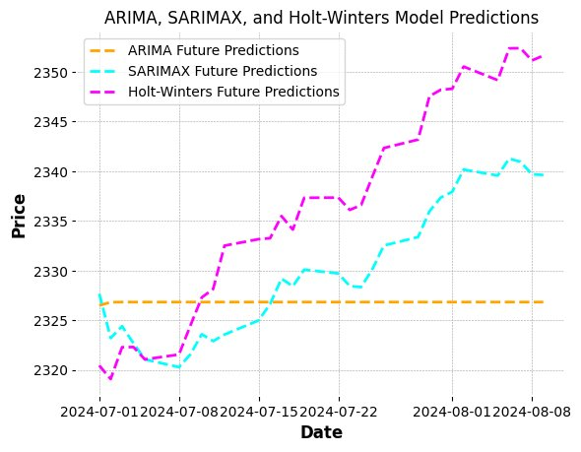
Why sarimax

Slide 21

Deployment
Install and Import Libraries:
Set up Streamlit and necessary libraries for data handling, visualization, and modeling.
Define Functions:
get_stock_data: Downloads and processes stock data.
sarimax_model: Fits the SARIMAX model, makes predictions, and calculates performance metrics.
Streamlit App:
Inputs: Users enter stock symbol, dates, and forecast steps.
Fetch Data: Retrieve and display stock data.
Fit Model: Apply SARIMAX model and show performance metrics.
Visualize Results: Plot historical data, predictions, and future forecasts.
Show Predictions: Display future predictions in a table.
Run App:
Launch the app for user interaction and visualization.

Slide 22
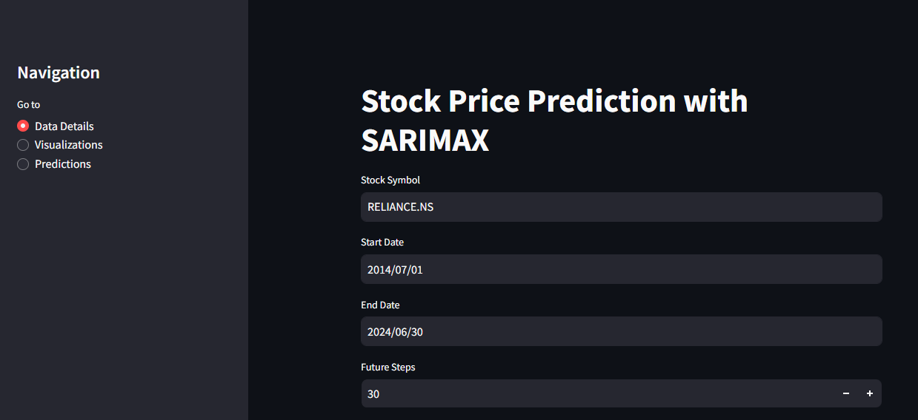
Deployed website AND PREDICTIONS

Slide 23
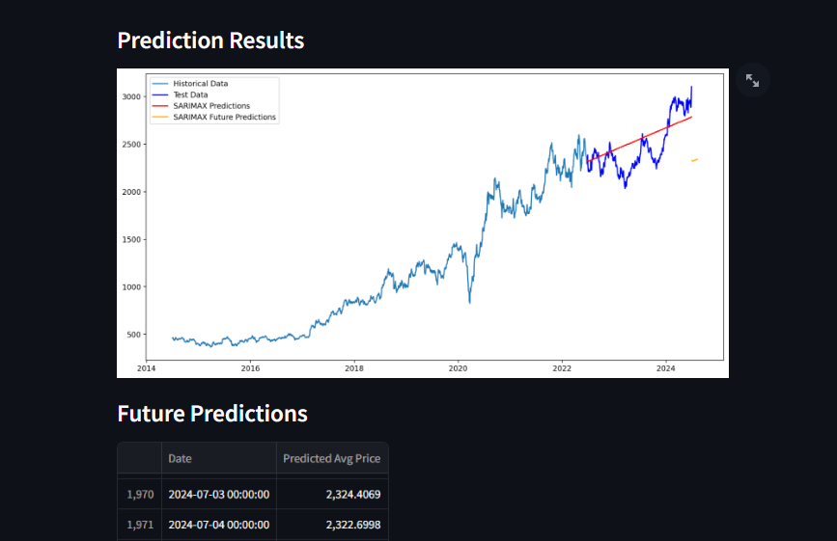
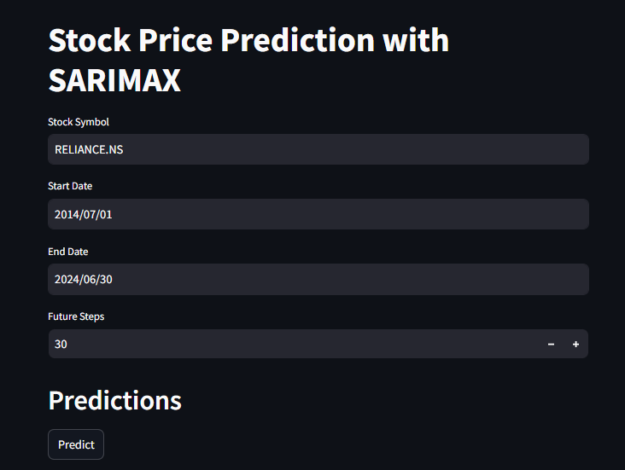
Deployed website AND PREDICTIONS

Slide 24
Challenges faced
1.Data Quality and Availability -
Handling Missing and Noisy Data: Incomplete or inaccurate stock data can impact model performance.
2. Feature Engineering and Model Selection
Feature Selection and Creation: Identifying and creating relevant features, including lag features, is crucial.
Choosing and Tuning Models: Selecting the right model (e.g., ARIMA, SARIMAX) and optimizing hyperparameters is complex.
3. Stationarity and Trends
Dealing with Non-Stationarity: Stock prices often show trends or seasonality, requiring transformations to achieve stationarity.
4. Evaluation and Prediction Uncertainty
Selecting Metrics and Avoiding Overfitting: Choosing appropriate evaluation metrics and ensuring the model generalizes well is challenging.
Managing Forecasting Uncertainty: Handling prediction uncertainty and potential model drift over time.
5. Visualization and Interpretation
Effective Visualization: Creating and interpreting clear visualizations to communicate results can be difficult.
6. External Factors
Incorporating Market Volatility:** External influences like economic events and market sentiment can impact predictions and are hard to model

Slide 25

Thank you

